Slide 1
C operators
C operators are symbols that are used to perform mathematical or logical manipulations.

Slide 2
Type of operator
Arithmetic Operators
Relational Operators
Logical Operators
Assignment Operators
Increment and Decrement Operators
Conditional Operator
Bitwise Operators
Special Operators

Slide 3
Arithmetic operator
Arithmetic Operators are used to performing mathematical calculations like addition (+), subtraction (-), multiplication (*), division (/) and modulus (%).

Slide 4
Eample
#include <stdio.h>
void main()
{
int i=3,j=7,k;
/* Variables Defining and Assign values */
k=i+j;
printf("sum of two numbers is %d\n", k);
}

Slide 5
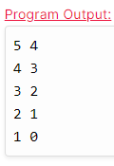
Prefix and postfix
#include <stdio.h>
//stdio.h is a header file used for input.output purpose.
void main()
{
//set a and b both equal to 5.
int a=5, b=5;
//Print them and decrementing each time.
//Use postfix mode for a and prefix mode for b.
printf("\n%d %d",a--,--b);
printf("\n%d %d",a--,--b);
printf("\n%d %d",a--,--b);
printf("\n%d %d",a--,--b);
printf("\n%d %d",a--,--b);
}

Slide 6
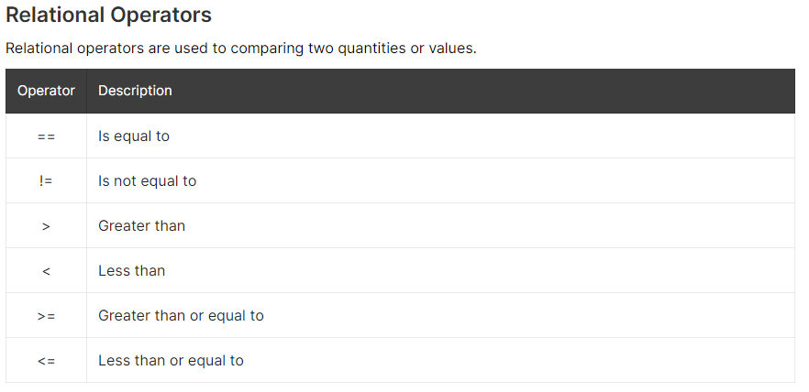

Slide 7
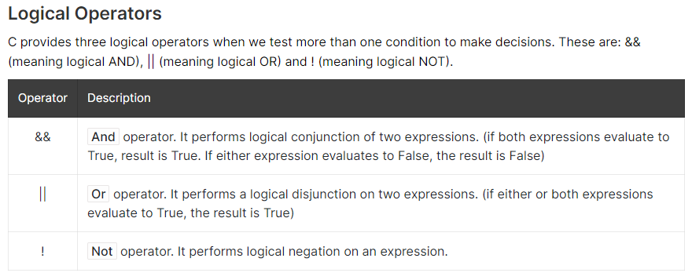

Slide 8
